Slide 1
Association of International Vascular Surgeons Minutes
Annual General Meeting
Four Seasons Hotel,
Whistler, Canada
Friday 13 March 2020 at 7.00pm

Slide 2
Recognition
  President Håkan Pärsson
  Local Organizers Vic and Linda Vucemilo, Richard and Leslie O’Connor, Emilio and Sharonna Rodriguez Marin Freudman
  Mac Dryjski
    Foundation Scholarship Support

Slide 3
Approval of Minutes AGM 2019
Hotel Ski & Wellness Residence Druzba, Demänovská Valley
Jasna, Slovakia.
Friday 8 March 2019 at 6.00pm
On Line (AIVSConf.org)

Slide 4
National Representative Attendance
Representative | Country | Attendance
ADELMAN Mark | Chairman | Present
BROOKS Marcus | England | Present
BUDTZ-LILLY Jacob | Denmark | Regrets
COVELIERS Hans | Belgium | Present
DRYJSKI Maciej | USA | Present
FURRER Markus | Switzerland | Present
GUILLEUMA Juan | Spain | Present
HOLZENBEIN Thomas | Austria
KONING Olivier | Netherlands | Present
KURTOGLU Mehmet | Turkey | Regrets
KUCZMIK Waclaw | Poland | Present
MADHAVAN Prakash | Ireland | Present
MARUSIAK Jan | Czechoslovakia | Regrets
MICHELOWSKI Kris (Pres Elect) | South Africa | Regrets
MONDEK Peter | Slovakia | Regrets
Håkan Pärsson (President) | Sweden | Present
SCHMITZ-RIXEN Thomas | Germany | Regrets
VUCEMILO Ivica | Canada | Present
McIRVINE Andrew | Webmaster | Present
SETERNES Arne | Norway | Invited
NOT REPRESENTED
AUSTRALASIA | PRAKASH MADHAVAN
FRANCE
ISRAEL
ITALY | MAC DRYJSKI
UAE
PORTUGAL | PRAKASH MADHAVAN

Slide 5
Resolved
Waclaw Kuczmik was invited to join Executive Committee as the Polish National Representative
Arne Seternes was invited to join Executive Committee as the Norwegian National Representative
Prakash Mahavan would contact potential interested parties from Portugal and Australia to encourage future attendance
Mac Dryjski would contact a potential interested party from Italy and Australia to encourage future attendance

Slide 6
AIVS annual accounts 2020
Michael Wyatt
Date | Income (£) | Expenditure (£) | Total (£)
Balance |  |  | 6008.65
Kris Michelowski €312 (Badkleinkircheim), Hakan Parsson €600, Peter Mondek €334

Slide 7
AIVS Foundation
Maciej Dryski (Presented by Mark Adelman)
Tax Exempt Organization
$11,000
  Mission- with the mission of providing finding for International intellectual exchange for trainees in vascular disease.
  Funded 2 trainees at Jasna ($1000 each)

Slide 8
Finlandia Prize 2020
Sean Crawford was voted best paper, However the work did not conform to 2020 rules of competition as it had been published in the past.
It was unanimously resolved that beginning 2021, Finlandia submissions may have been published within 12 months of Finlandia submission deadline.

Slide 9
Ties, Scarves and Pouchettes
Still available
Ties, Scarves and Pouchettes (€30, €20)

Slide 10
Reports (Past and Current Meetings)
Report on Jasna, Slovakia meeting (Peter Mondek and Presented by Mark Adelman)
Report on Whistler, Canada Ivica Vucimilo

Slide 14
Future Meetings
i. 2021, Soelden , Austria, (Olivier Koning) 13-20 March 2021
ii. 2022, tba (Prakash Madhavan)
iii. 2023 (Hans Coveliers)

Slide 15
39th AVIS Congress
13-20 March 2021
Soelden, Austria
Olivier Koning

Slide 16
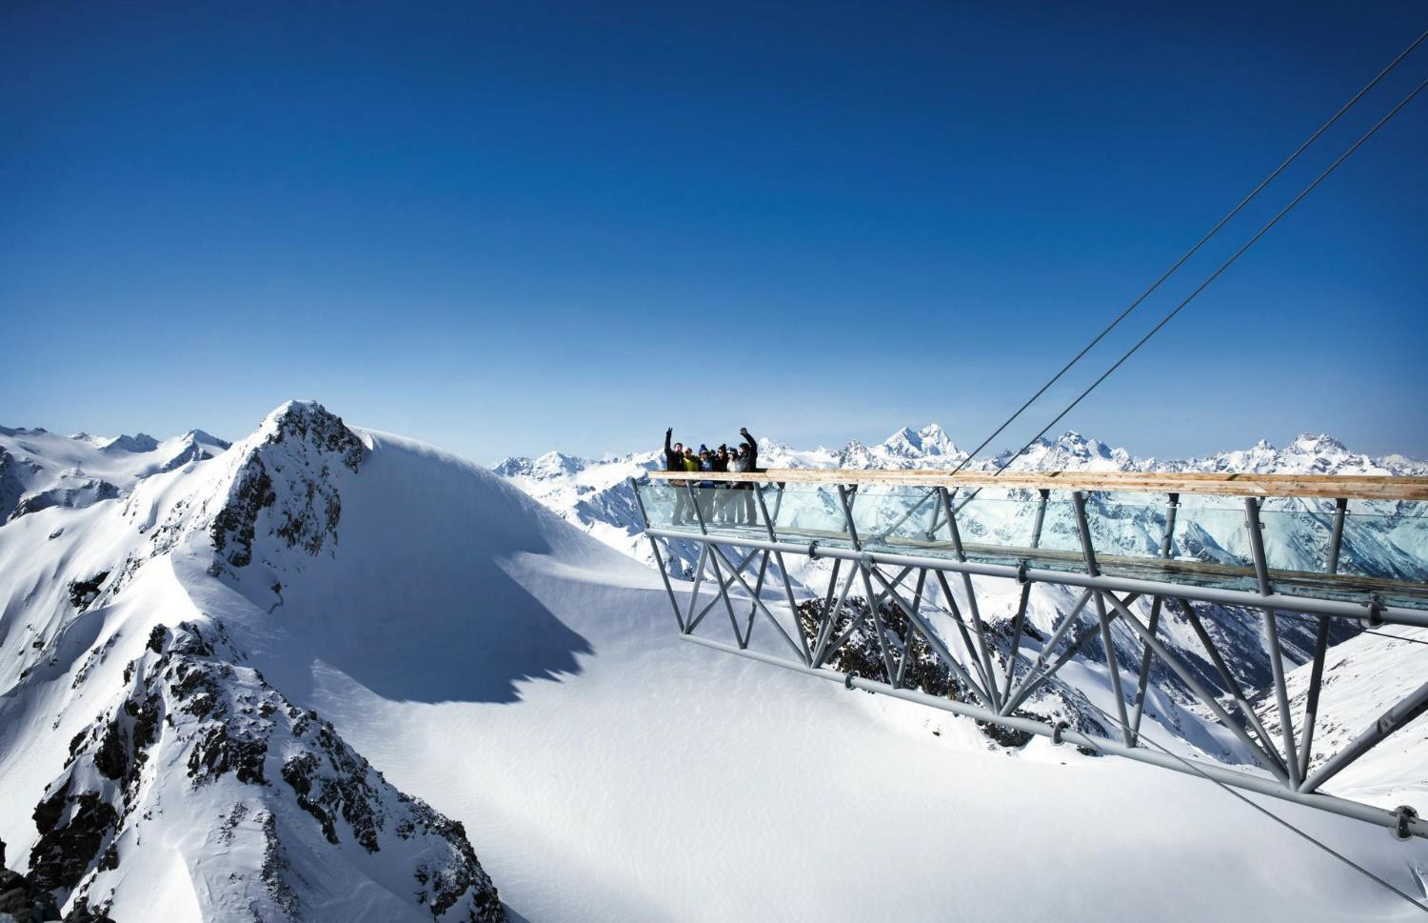


TU WPISZ: INFORMACJE
AIVS CONFERENCE 2021
Participants: 120
Dates: 13-20 March 2021
Hotel: Tyrolerhof 4*
Place: Austria, Soelden
AIVS CONFERENCE 2021 - SOELDEN, AUSTRIA

Slide 17
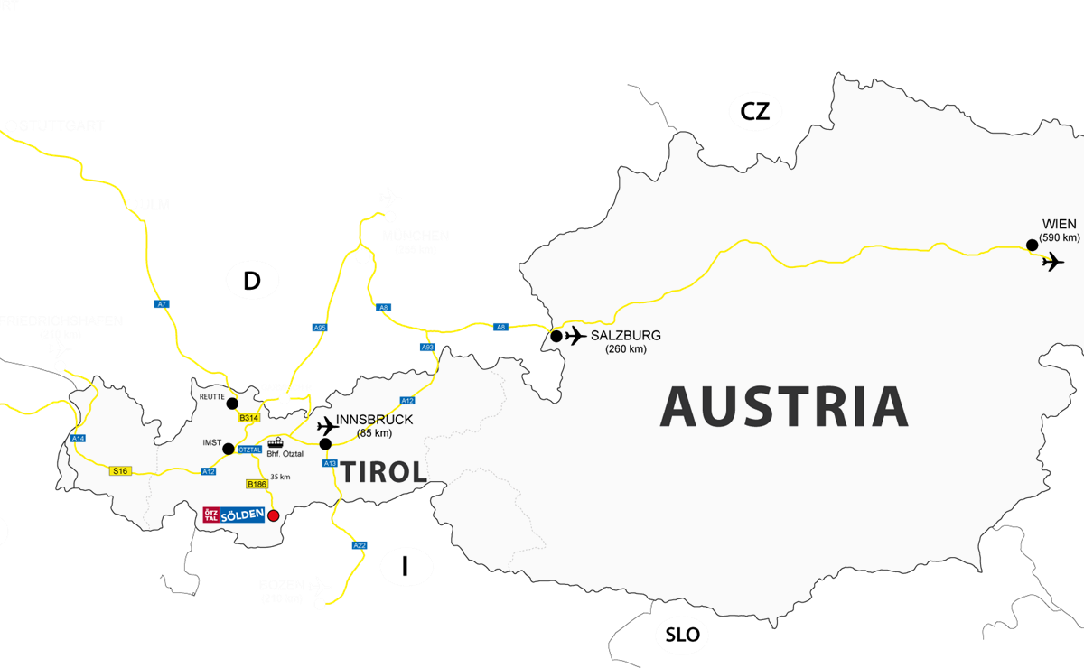

SOELDEN, AUSTRIA. LOCATION.
MUNICH AIRPORT
(240 km)
DISTANCES FROM AIRPORTS
Innsbruck 85 km
Munich 240 km
Salzburg 260 km
www.activezone.pl © 2018 wszystkie prawa zastrzeżone.
2

Slide 18
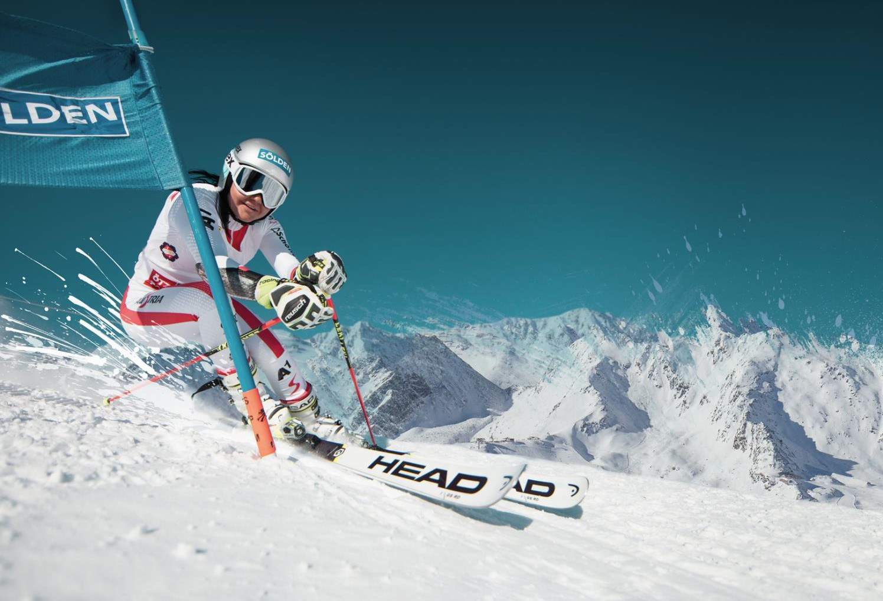
SOELDEN, AUSTRIA. ABOUT THE REGION.
Internationally renowned
Two glaciers
Hight altitude above sea lewel (3.250 m)
144 km ski slopes
Famous and fashionable ski region
Long ski season
Snow guarantee
Sölden is internationally renowned for its action on and off the slopes. The World Cup venue boasts a huge ski area with absolute snow reliability, which is the only one in Austria that has opened up three peaks higher than three thousand meters. Skiers and snowboarders reach the 144 immaculate slope kilometers with the two most powerful feeder mountain gondolas worldwide - afterwards they indulge into the legendary après-ski and nightlife scene of Sölden. Countless big events are scheduled from October to early May, promising exuberant party mood throughout the season.
www.activezone.pl © 2018 wszystkie prawa zastrzeżone.
3

Slide 19
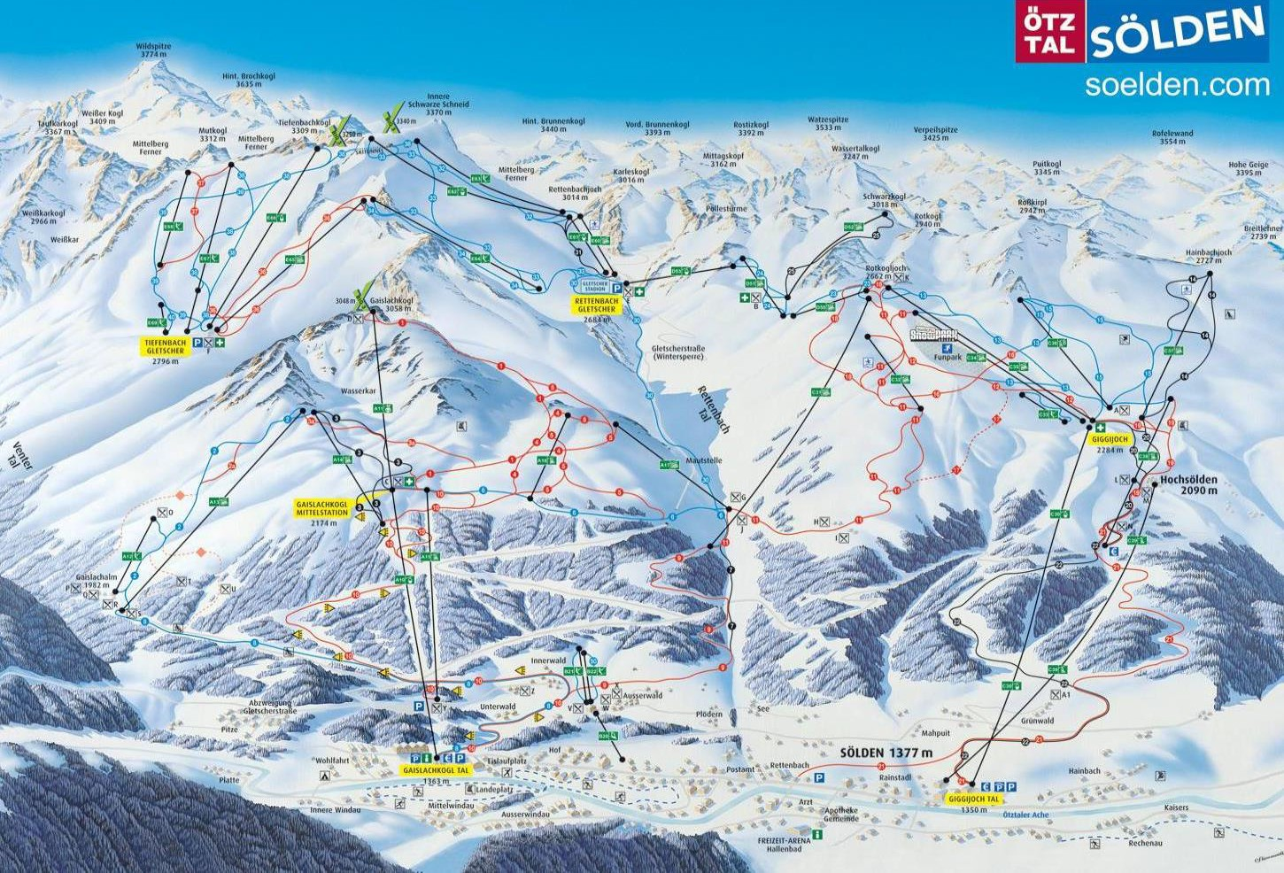
SOELDEN, AUSTRIA. SKI REGION.
144 km of ski pists
1350 m – lowest ski station
3250 m – higher ski station
Two glaciers
Highest ski lift: 3250 m a.s.l. Base: 1350 m a.s.l.
Ski pistes total length: 144 km, easy- 69 km, intermediate - 45 km, difficult - 30 km Ski lifts: 35. As for today there are 3.7 metres of snow covering the summit.
www.activezone.pl © 2018 wszystkie prawa zastrzeżone.
4

Slide 20
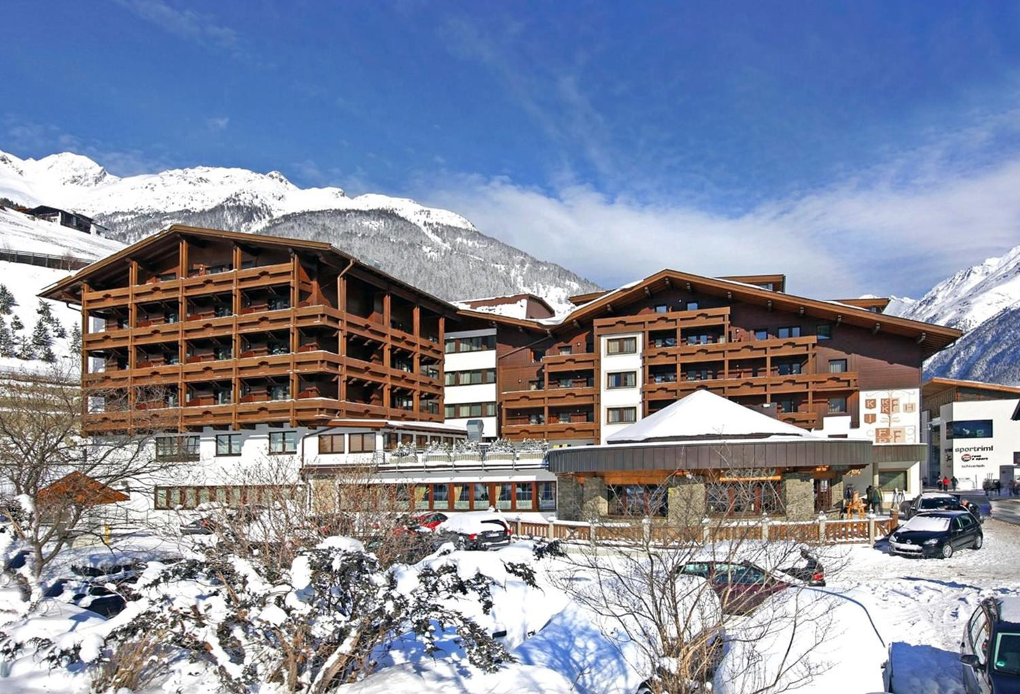
SOELDEN, AUSTRIA. HOTEL TYROLERHOF.
Standard 4*
Central location
3 min. Walk to ski station
Swimming pool and welness
Conference room
Internet access
Booking.com: 8.8
www.activezone.pl © 2018 wszystkie prawa zastrzeżone.
5

Slide 21
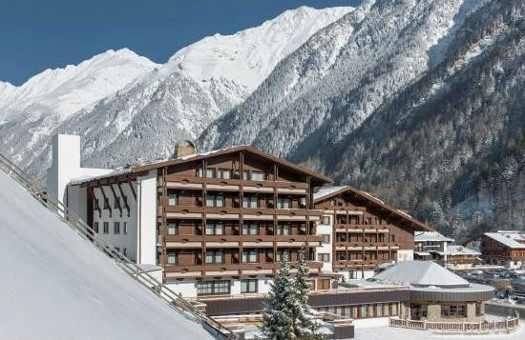

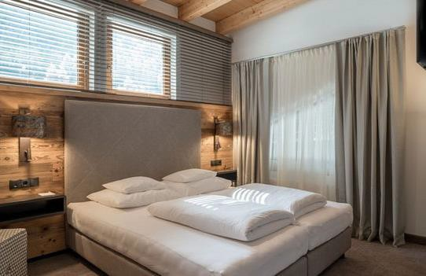
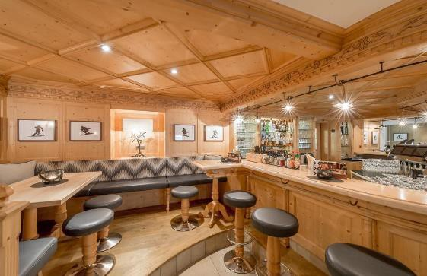
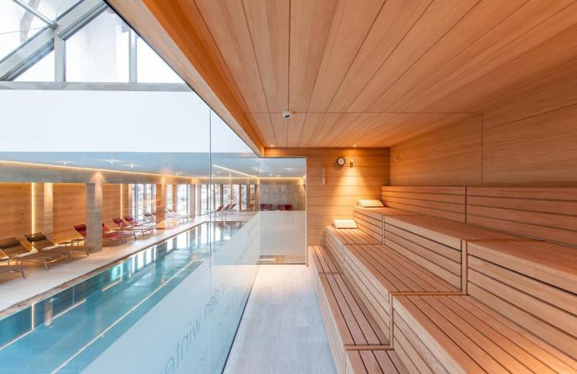
HOTEL TYROLERHOF 4*
Hotel Tyrolerhof 4* is located at the centre of Sölden, a 2-minute walk from the Freizeitarena leisure centre and only 300 m away from the Giggijoch Cable Car.
The modern rooms all feature cable TV, a safe, and a bathroom with hairdryer.
The on-site restaurant offers Tyrolean cuisine as well as international dishes.
Guests can relax in front of the bar’s open fireplace. Free WiFi is available in the lobby and in all rooms. There is also a cozy bar at the hotel – Grizzly Bar. There is a nice wellness area at the hotel. There are: indoor pool 19x6 m, a hot tub, a Finnish sauna and an infrared sauna.
There is a conference room at the hotel for up to 80 persons.
www.tyrolerhof-soelden.com
ATUTY HOTELU:
Booking.com: 8.8
Central location
Swimming pool
Welness
Conference room

Slide 22
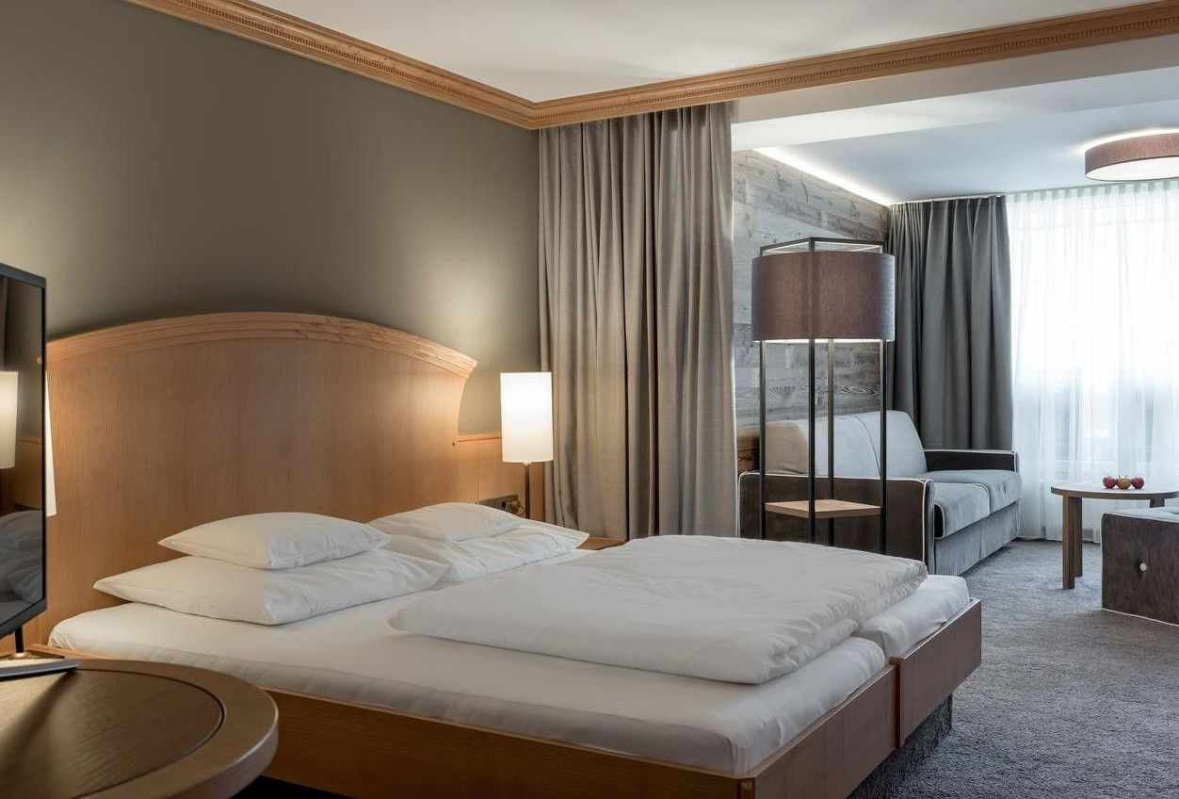
SOELDEN, AUSTRIA. HOTEL TYROLERHOF. STANDARD ROOM.
The rooms in the hotel are furnished comfortable and stylish. All rooms have bath or shower and WC, hair dryer, radio, telephone, cable TV and room safe.
A few room types
www.activezone.pl © 2018 wszystkie prawa zastrzeżone.
7

Slide 23
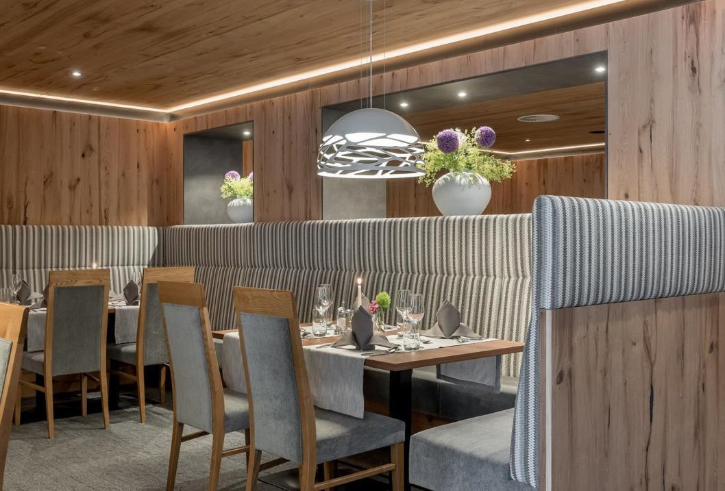
SOELDEN, AUSTRIA. HOTEL TYROLERHOF. RESTAURANT.
Traditional food of Tirol and international fare.
Wine cellar.
rich breakfast buffet with local delicacies
delicacy buffet in the evening: starters, soups, salads, main dishes and desserts
www.activezone.pl © 2018 wszystkie prawa zastrzeżone.
8

Slide 24
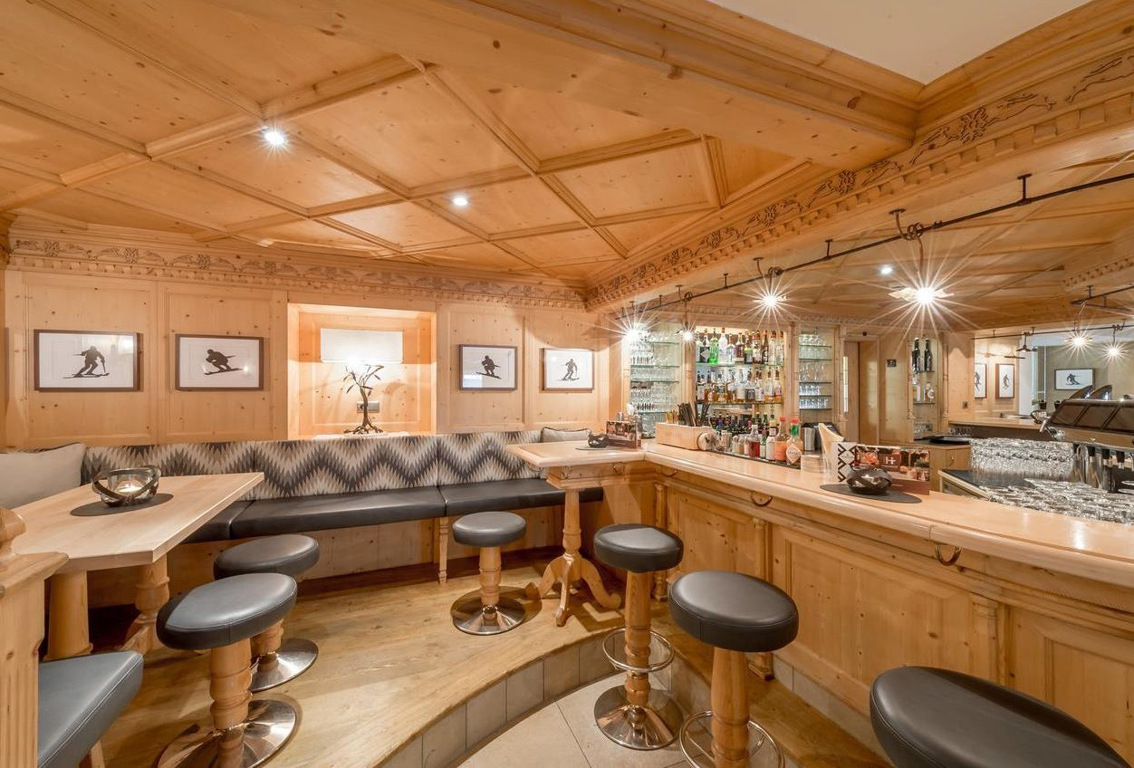
SOELDEN, AUSTRIA. HOTEL TYROLERHOF. BAR GRIZZLY.
Cozy and unformal bar at the hotel
www.activezone.pl © 2018 wszystkie prawa zastrzeżone.
9

Slide 25
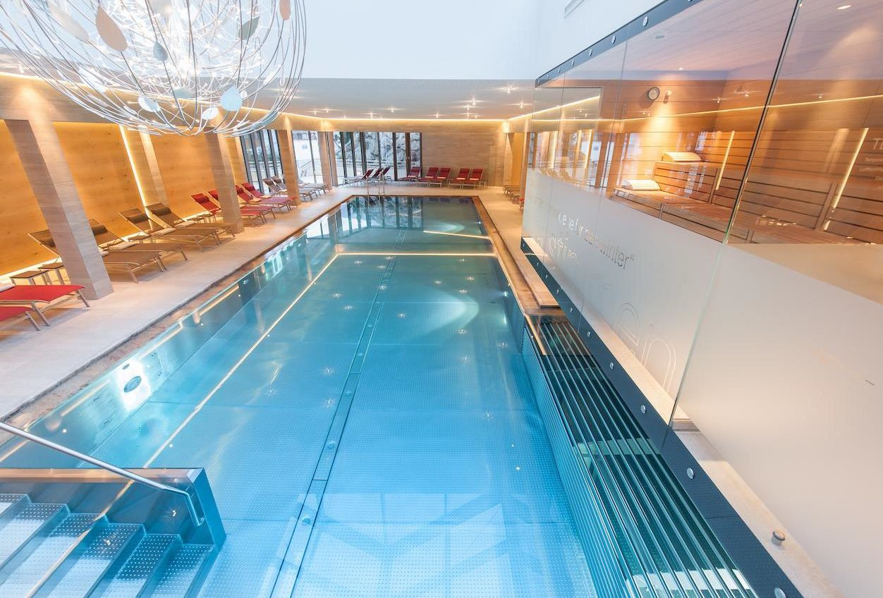
SOELDEN, AUSTRIA. HOTEL TYROLERHOF. SWIMMING POOL AND WELNESS.
the wellness area:
swimming pool 19 x 6
textile sauna, infrared sauna
steam bath,
ice grotto
relaxation room
gym room
www.activezone.pl © 2018 wszystkie prawa zastrzeżone.
25
10

Slide 26
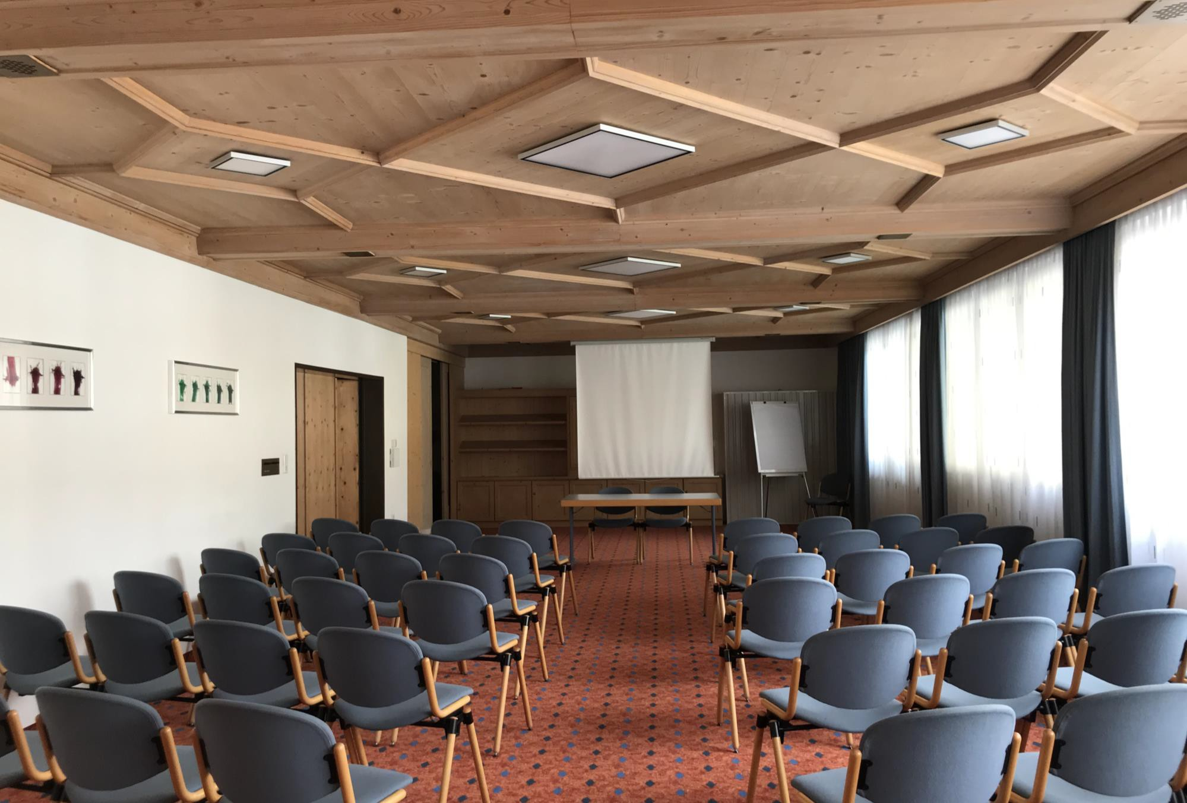
SOELDEN, AUSTRIA. HOTEL TYROLERHOF. CONFERENCE ROOM.
Seminar room with:
flipchart,
overhead,
TV,
video,
internet access
www.activezone.pl © 2018 wszystkie prawa zastrzeżone.
26
10

Slide 27
DESCRIPTION
HOTEL TIROLERHOF 4*, SOELDEN, 13th-20th of March 2021 | 2880 EUR/per room for 2 persons
COSTS INCLUDED:
Accommodation in standard room for 2 persons, 7 nights Rich breakfasts bufet
Buffet dinners
Drinks package for dinners: 1/3 bottle of wine and water per person Afternoon tea – five o’clock
Free entrance to the wellness area and swimming pool
NOT INCLUDED
Skipass, local tax, parking , private expenses
www.activezone.pl © 2018 wszystkie prawa zastrzeżone.
27
10

Slide 28
SHOOTING LOCATION FOR JAMES BOND "SPECTRE" – ICE Q RESTAURANT
SEE YOU IN SOELDEN.
www.activezone.pl © 2018 wszystkie prawa zastrzeżone.
28
10

Slide 29
AIVS 2022--Prakash Madhavan
No final resolution for location
If travel will allow, Mr. Madhavan will travel to KOENIGSLEITEN, AUSTRIA to determine appropriateness for AIVS

Slide 30
Proposal for AIVS 2022
Organising Committee
Zenia Martin
Mary-Paula Colgan
Adrian O’Callaghan
Prakash Madhavan
& Spouses!

Slide 31
Proposal for AIVS 2022
Good Hotel
Close to airports
Ski in and Ski Out
Conference facilities
High enough resort
Reasonably priced

Slide 32
Issues
Hotels and resorts reluctant to engage so far in advance
Engaged with Activzone to do the groundwork
Good track record in dealing with other AIVS meetings

Slide 33
Resort | KOENIGSLEITEN, AUSTRIA | VAL THORENS, FRANCE | PEISEY-VALLANDRY, FRA
Hotel | HOTEL ALPENWELT | HOTEL CLUB MED 4* ALL INCLUSIVE | HOTEL CLUB MED 4* ALL INCLUSIVE
Star | **** | **** | ****
Area | Zillertal Arena | Les3Vallées–ValThorens/​LesMenuires/​Méribel/​Courchevel | Paradiski ski area,
Altitude | 580 - 2,500m. | 1,100- 3230 m | 1200m -3226m
Ski Area | 143 km slopes 52 lifts | Ski slopes: 600 km §Ski lifts: 137 §Blue routes: 312km §Red routes: 216km §Black routes: 72km | Ski slopes: 200km §Ski lifts: 54 §Blue routes: 104km §Red routes: 70km §Black routes: 26km
Airports | Innsbruck: 65 km Salzburg : 163 km Munich : 188 km | Geneva: 142 km Lyon: 196km Chambery: 112 km Grenoble: 186 km | Geneva: 195 k Lyon: 195 k Chambery: 108 k Grenoble: 179 k

Slide 34
Hotel Facilities | Ski in Ski Out Ski Room Free Wifi Spa area Sauna | Spa, 2 restaurants, 2 Bars | Ski in Ski Out 2 restaurants and 2 bars in the hotel. SPA area consists of heated outdoor pool, indoor pool, sauna, jacuzzi/hot tub and gym.
 | www.alpenwelt.net | https://www.clubmed.co.uk/r/Val-Thorens-Sensations/y | https://www.clubmed.co.uk/r/Peisey--Vallandry/w
Half Board | Generous gourmet-breakfast buffet ü1 breakfast with Prosecco üIn the afternoon: cake buffet from 2 pm to 4 pm ü5-course gourmet dinner incl. salad bar with 3 main courses to choose from üSoup or appetizer from buffet, partially dessert buffet and cheese buffet üRegional agricultural products | Premium accommodation üAll-day gourmet dining & open bar, additional between meal snack for skiers, aperitifs and refreshments at anytime üAccess to the CLUB MED SPA üSki passes üSki and snowboard instructors üAfter-Ski activities& entertainment | Premium accommodation üAll-day gourmet dining& open bar, additional between meal snack for skiers, aperitifs and refreshments at anytime üAccess to the CLUB MED SPA üSki passes üSki and snowboard instructors üAfter-Ski activities & entertainment

Slide 35
Cost | 2870 EUR per double room | 4180 EUR per double room | 4180 EUR per double room
Not Included | Local tax •Ski passes •Ski/snowboard rental •Ski instructors •Transfers •Flights | Local tax •Transfers •Flights •Ski/snowboard rental | Local tax •Transfers •Flights •Ski/snowboard rental
Ski Pass 7 days | 300 | 300 | 270

Slide 36
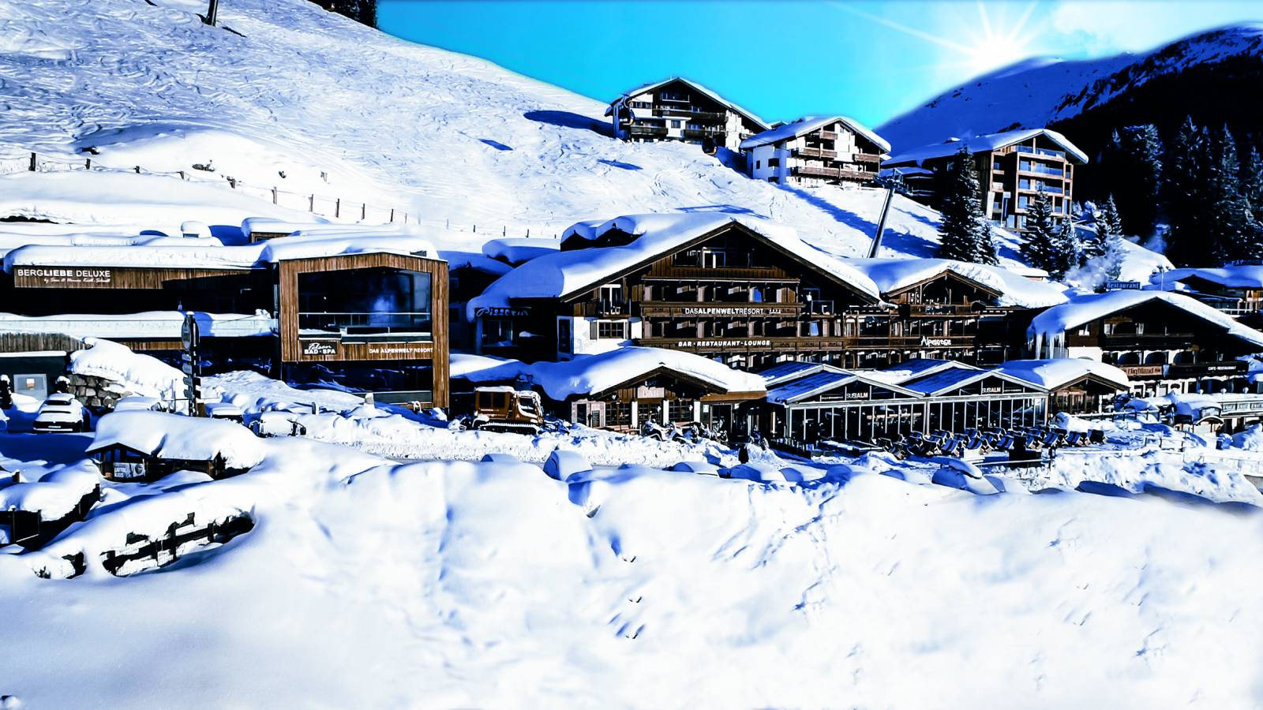
KOENIGSLEITEN, AUSTRIA

Slide 37
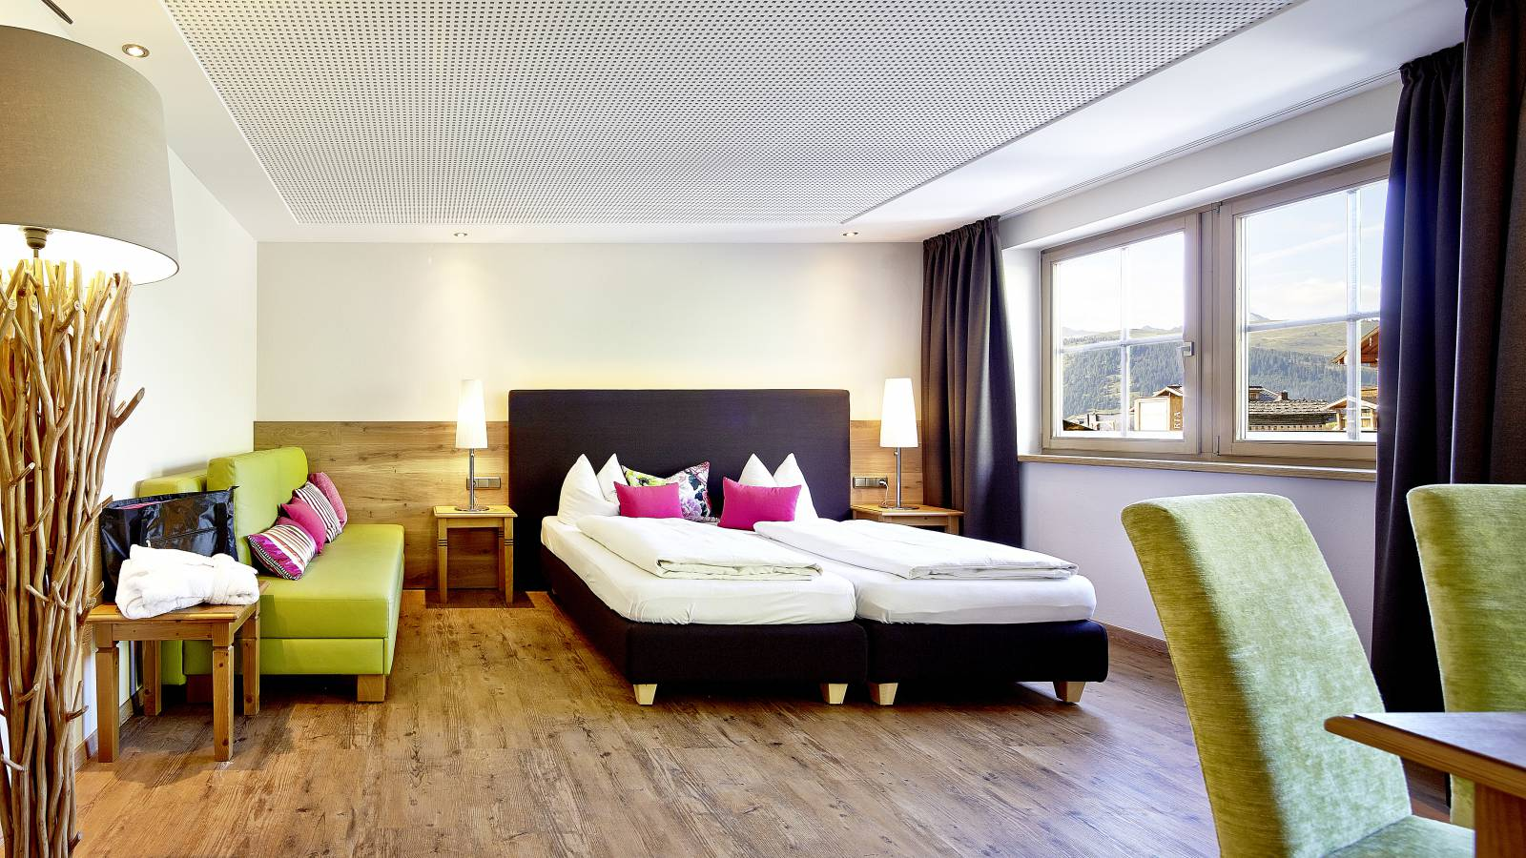
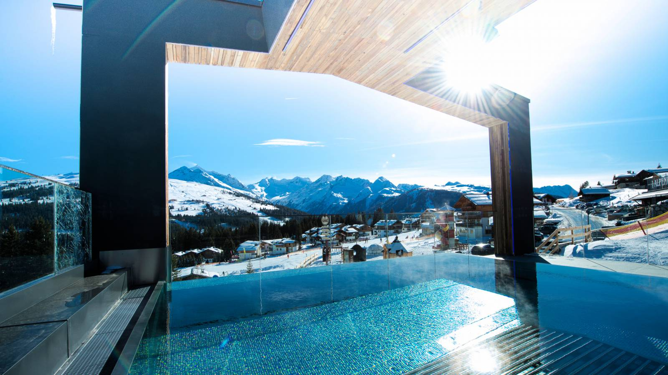

Slide 38
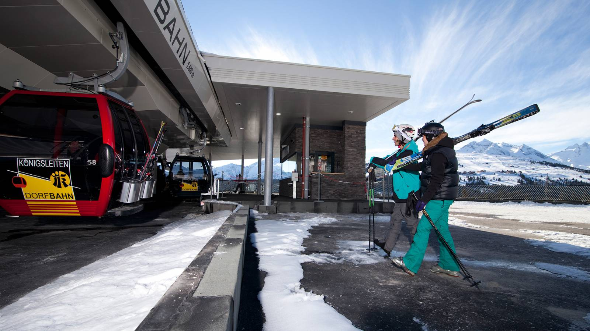
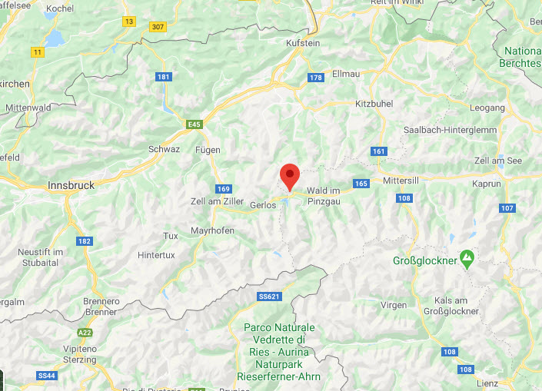
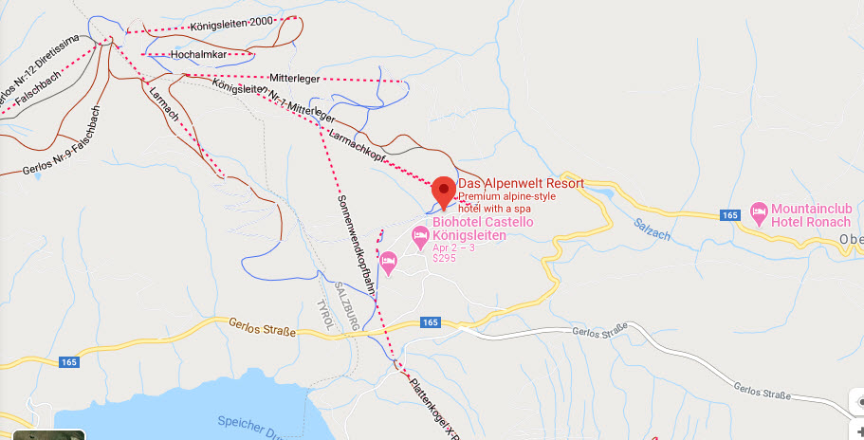

Slide 39
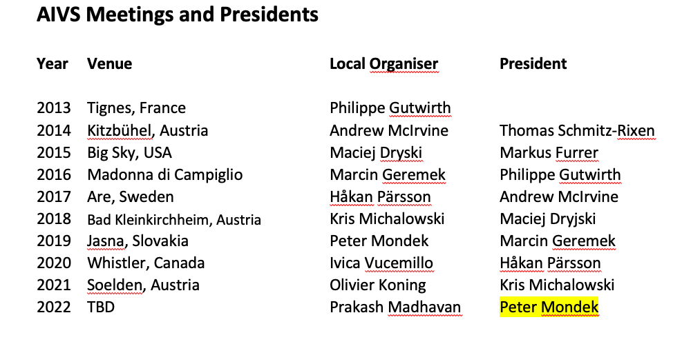
Election of President 2022

Slide 40
Resolutions
Peter Mondek would be elected unanimously as President for 2022
Hans Coveliers would serve as local organizer for 2023
No New Business
Next AGM in Soelden, Austria 19-MARCH 2021
MEETING WAS ADJOURNED

